Slide 1
Heart Attack
Understanding Risks Factors & Prevention
Notes:
http://en.wikipedia.org/wiki/Heart_attack
This sample presentation will illustrate the Power of PowerDESIGNS. We start off by selecting a background template from the PowerTEMPLATES collection.

Slide 2
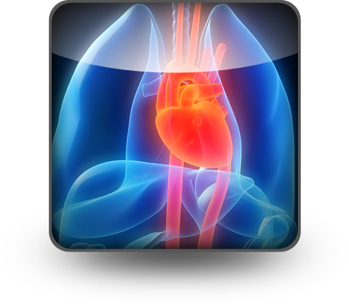
Definition
HEART ATTACK
the interruption of blood supply to part of the heart, causing some heart cells to die
Notes:
This PowerICON is used to add imagery and impact.

Slide 3
Heart Attack Symptoms
Sudden Chest Pain
Sweating
Anxiety
SEEK
HELP
Palpitations
Shortness of Breath
Nausea and Vomiting
Notes:
Here, PowerGraphics are used in conjunction with PowerICONS to create an interactive graphic

Slide 4
Heart Attack Symptoms
25%
Are Silent
Without Chest Pain Or Other Symptoms
Notes:
Many creative diagrams like this sphere are included in the PowerGRAPHICS library.

Slide 5
Leading Cause of Death
Heart attacks are the leading cause of death for both MEN and WOMEN all over the world
Notes:
3d PowerGRAPHICS are an exciting way to illustrate key concepts and keep your audience entertained

Slide 6
Important Risk Factors
Previous cardiovascular disease
Older age
Tobacco smoking
High levels of certain lipids and low levels of high density lipoprotein
Excessive alcohol consumption and drug abuse
Diabetes
High blood pressure
Obesity
Chronic kidney disease
Heart failure
Chronic high stress levels
Notes:
PowerICONS are used to emotionally connect with the audience make slides memorable.

Slide 7
Prevention
RECURRENT RISK
Decreases with:
Strict blood pressure management
Lifestyle changes (smoking cessation)
Regular exercise
Sensible diet
Limitation of alcohol intake
Notes:
3D Arrows from the PowerGRAPHICS library are used to create this exiting animation effect.

Slide 8
Products and Services for Microsoft PowerPoint®
www.PresentationPro.com
PresentationPRO | 800-379-6393

